Slide 1

COMPLAINT Redressal system
RLL PROJECT – TEAM 8

Slide 2
Rll Group-8
EmployeeId Name
2528681 Sweatha S
2528253 Syamakuru Viswa Teja Reddy
2528286 Tariquz Zaman Laskar
2526061 Thallapureddy sai Preetham Reddy
2527452 Vengala Subba Reddy
2526619 Vikas Yadav
2528045 Vishnu Vardhini Sakthivel
2526694 Yarabati Santhosh Kumar
2527993 Yuvarani M

Slide 3
introduction
Domain: Telecom
Project Objective:
Create a dynamic and responsive Java Complaint Redressal System web application for online complaint management system where the customers can raise complaints regarding their landlines and broadband services.
Tools and Technologies Used:
Front-End: Angular
Server-side: Spring Boot.
Back-end: MYSQL, Hibernate.
Server: Tomcat

Slide 4
TOPICS
SPRING BOOT
(BACKEND)
ANGULAR
(FRONTEND)
TESTING

Slide 5

ANGULAR
What is Angular?
Angular is a development platform, built on Typescript.
As a platform, Angular includes:
A component-based framework for building scalable web applications
A collection of well-integrated libraries that cover a wide variety of features, including routing, forms management, client-server communication, and more
A suite of developer tools to help you develop, build, test, and update your code

Slide 6
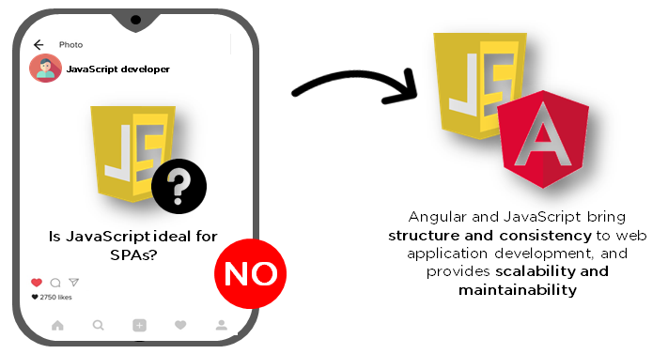
Why Angular?
Angular is a highly popular web development framework that offers rich user experiences, fast responsiveness, and code maintainability. It is the fourth most used front-end web framework.

Slide 7
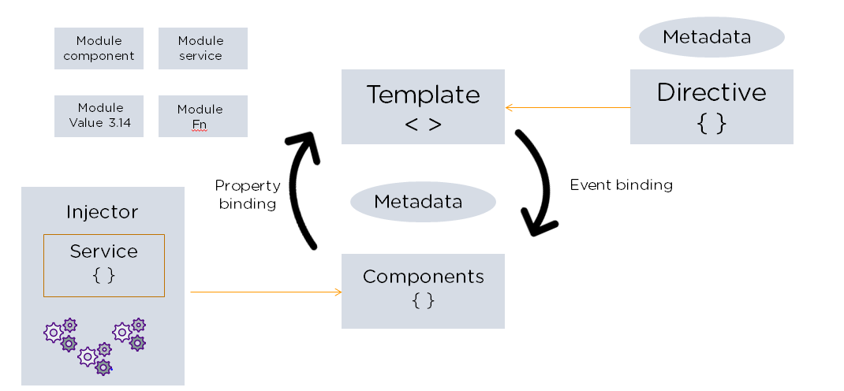
Angular Architecture:
Angular is a full-fledged model-view-controller (MVC) framework. It provides clear guidance on how the application should be structured and offers bi-directional data flow while providing real DOM.

Slide 8
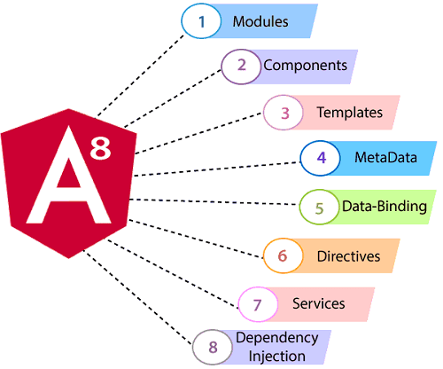
Building Blocks Of Angular:

Slide 9
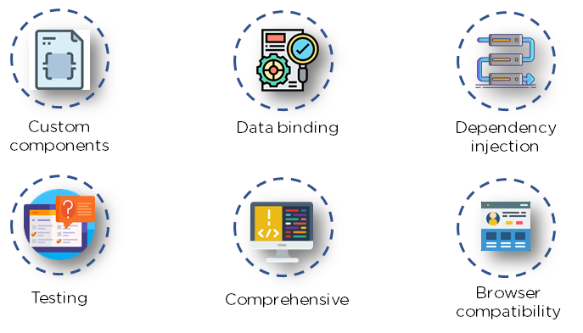
Advantages Of Angular:

Slide 10

SPRING BOOT
What is Spring Boot?
Spring Boot provides a good platform for Java developers to develop a stand-alone and production-grade spring application that you can just run. You can get started with minimum configurations without the need for an entire Spring configuration setup.
The entry point of the spring boot application is the class contains @SpringBootApplication annotation and the main method.

Slide 11
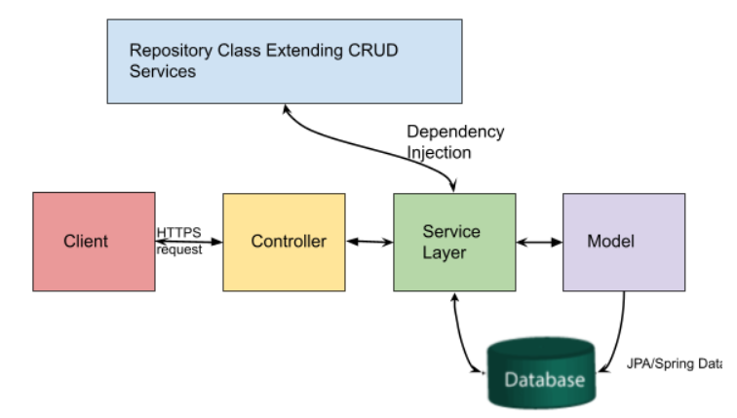
Architecture Of Spring Boot:

Slide 12

About Micro Services:
Spring Boot is an open source Java-based framework used to create a micro Service.
Micro Service is an architecture that allows the developers to develop and deploy services independently.
Each service running has its own process and this achieves the lightweight model to support business applications.

Slide 13
About Annotations:
@Autowired
The annotation @Autowired in spring boot is used to auto-wire a bean into another bean. The annotation @Autowired helps to auto wire the collaborative beans in spring boot framework. The autowired spring boot bean is eligible for use in Spring boot.
@ComponentScan
Spring Boot automatically scans all the components included in the project by using @ComponentScan annotation.
@RestConroller
Spring RestController annotation is used to create RESTful web services using Spring MVC.
The RestController allows to handle all REST APIs such as GET, POST, Delete, PUT requests.

Slide 14
@Service
It is used to mark the class as a service provider. So overall @Service annotation is used with classes that provide some business functionalities. Spring context will autodetect these classes when annotation-based configuration and classpath scanning is used.
@Repository
Spring @Repository annotation is used to indicate that the class provides the mechanism for storage, retrieval, search, update and delete operation on objects.
@Entity
It specifies that the class is an entity and is mapped to a database table. The @Table annotation specifies the name of the database table to be used for mapping.

Slide 15
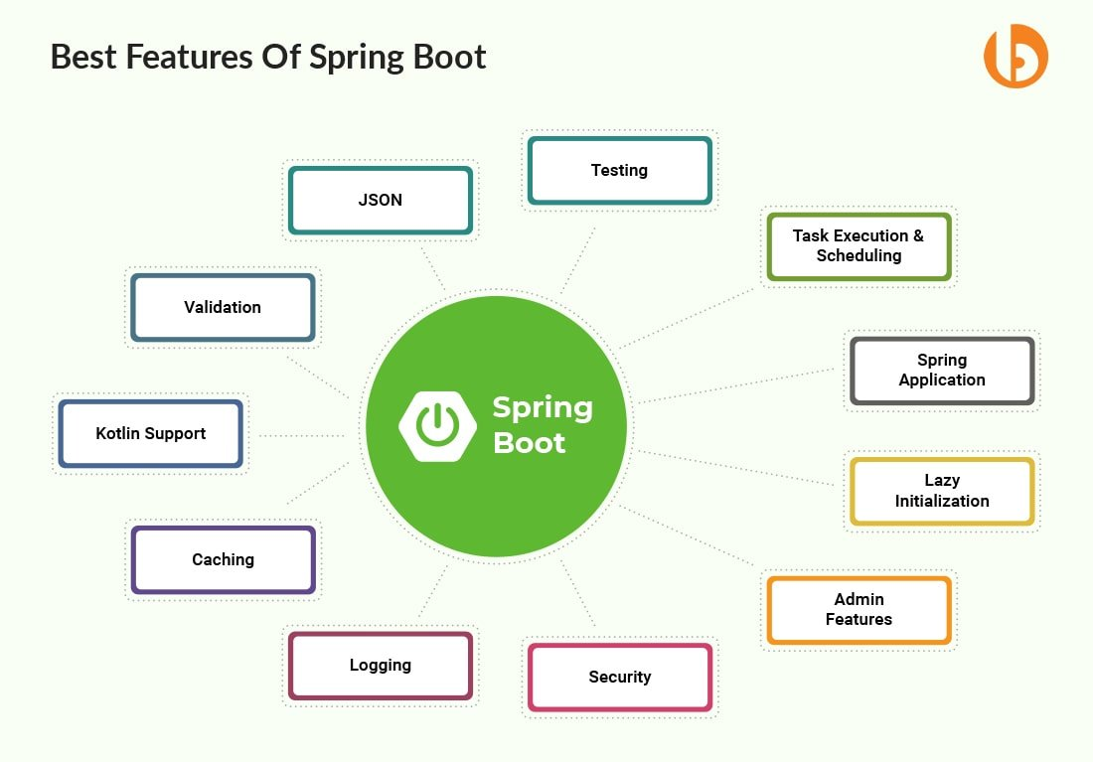
Advantages Of Spring Boot:

Slide 16
Modules
ADMIN
CUSTOMER
MANAGER
ENGINEER

Slide 17
ADMIN
VIEW MANAGERS
ADMIN
VIEW ENGINEERS
VIEW CUSTOMERS
VIEW COMPLAINTS
VIEW FEEDBACKS

Slide 18
ADMIN MODULE (FRONTEND)
In admin module , admin can view the Manager, Customer, Engineer, Complaint, Feedback modules.
Admin can update and delete task from the Manager, Customer, Engineer, Complaint, Feedback modules.

Slide 19
Admin Module(Backend)
1. Managing the lifecycles of manager, engineer, customer
2. Total we are having 5 operations:
view managers(@GetMapping()):In manager controller
Two operations :Delete (@DeleteMapping()),update(@PutMapping()) on managers
view engineers(@GetMapping()):In engineer controller
Two operations :Delete engineers(@DeleteMapping())
view customers(@GetMapping()):In customer controller
Two operations :Delete(@DeleteMapping()),update(@PutMapping()) on customers
view complaints(@GetMapping()):In complaint controller
Two operations :Delete(@DeleteMapping()),update(@PutMapping()) on complaints
view feedbacks(@GetMapping()):In feedback controller
Two operations :Delete(@DeleteMapping()),updtae(@PutMapping()) on feedbacks

Slide 20
CUSTOMER
CUSTOMER
REGISTER
LOGIN
COMPLAINTS
VIEW COMPLAINT STATUS
SEND FEEDBACKS

Slide 21
CUSTOMER MODULE (FRONTEND)
In customer module, the customer can register and then sign in .
After signing in, it will be redirected to the complaint module
In complaint module, the customer can raise the complaints.
After submitting the complaint the customer can give the feedback.
In complaint module, the customer can also view complaints and feedbacks.

Slide 22
Customer module(backend)
Sign up(PostMapping()):In customer controller
Sign in(PostMapping()):In customer controller
Raise Ticket(postmapping()):In complaint controller
View complaints of that customer():In complaint controller
After viewing the status of complaint, send feedback(postMapping()):In feedback controller

Slide 23
MANAGER
MANAGER
REGISTER
LOGIN
VIEW ALL COMPLAINTS
VIEW ALL FEEDBACKS
ASSIGN ENGINEERS

Slide 24
MANAGER (FRONTEND)
In manager module , the manager can register and then sign in.
After signing in, the manager can redirected to the manager dashboard.
In dashboard , manager can view all the complaints and the feedback.
The manager will assign the complaints to the engineers by using the engineer’s mail id.

Slide 25
Manager Module (Backend)
Sign up(PostMapping()):In manager controller
Sign in(PostMapping()):In manager controller
View Complaints(GetMapping()):In manager controller(view by manager pincode)
Assign engineer(PostMapping()):In engineer_duty controller
View Feedback(@Getmapping()):In feedback controller

Slide 26
ENGINEER
ENGINEER
REGISTER
LOGIN
VIEW ALL COMPLAINTS
VIEW ALL FEEDBACKS
STATUS

Slide 27
ENGINEER MODULE (FRONTEND)
In Engineer module, engineer can register and then sign in.
After Signing in , engineer can redirected to the dashboard.
They can view complaints and feedbacks.
By clicking view all complaints ,engineers can update the status of the complaints.

Slide 28
Engineer Module (Backend)
Sign up(PostMapping()):In Engineer controller
Sign in(PostMapping()):In Engineer controller
View Complaints(@GetMapping()):In Complaint Controller
Update the status(@PutMapping()):In complaint controller
View Feedback(@Getmapping()):In feedback controller

Slide 29

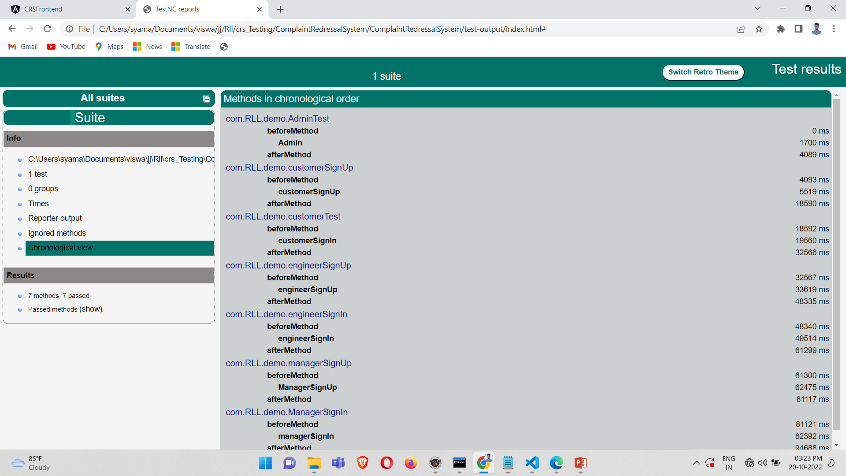
testing

Slide 30
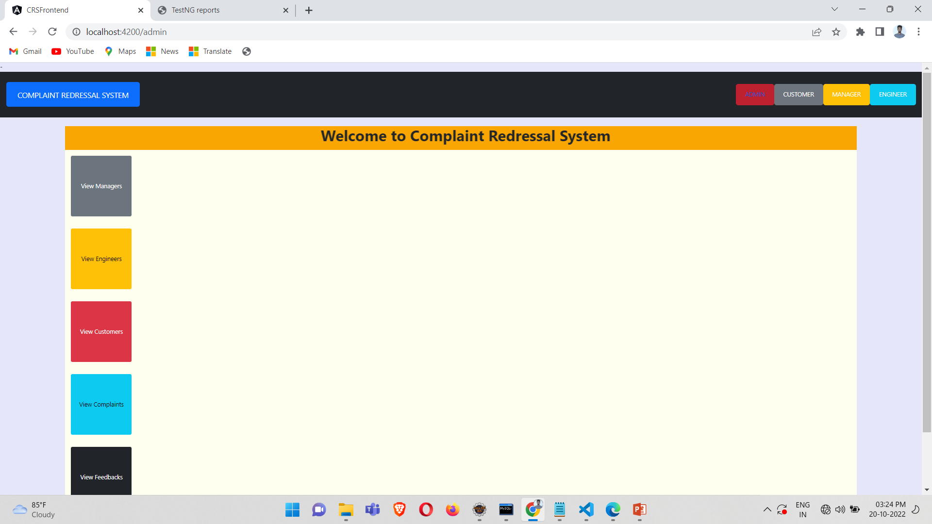
Output screenshots

Slide 31
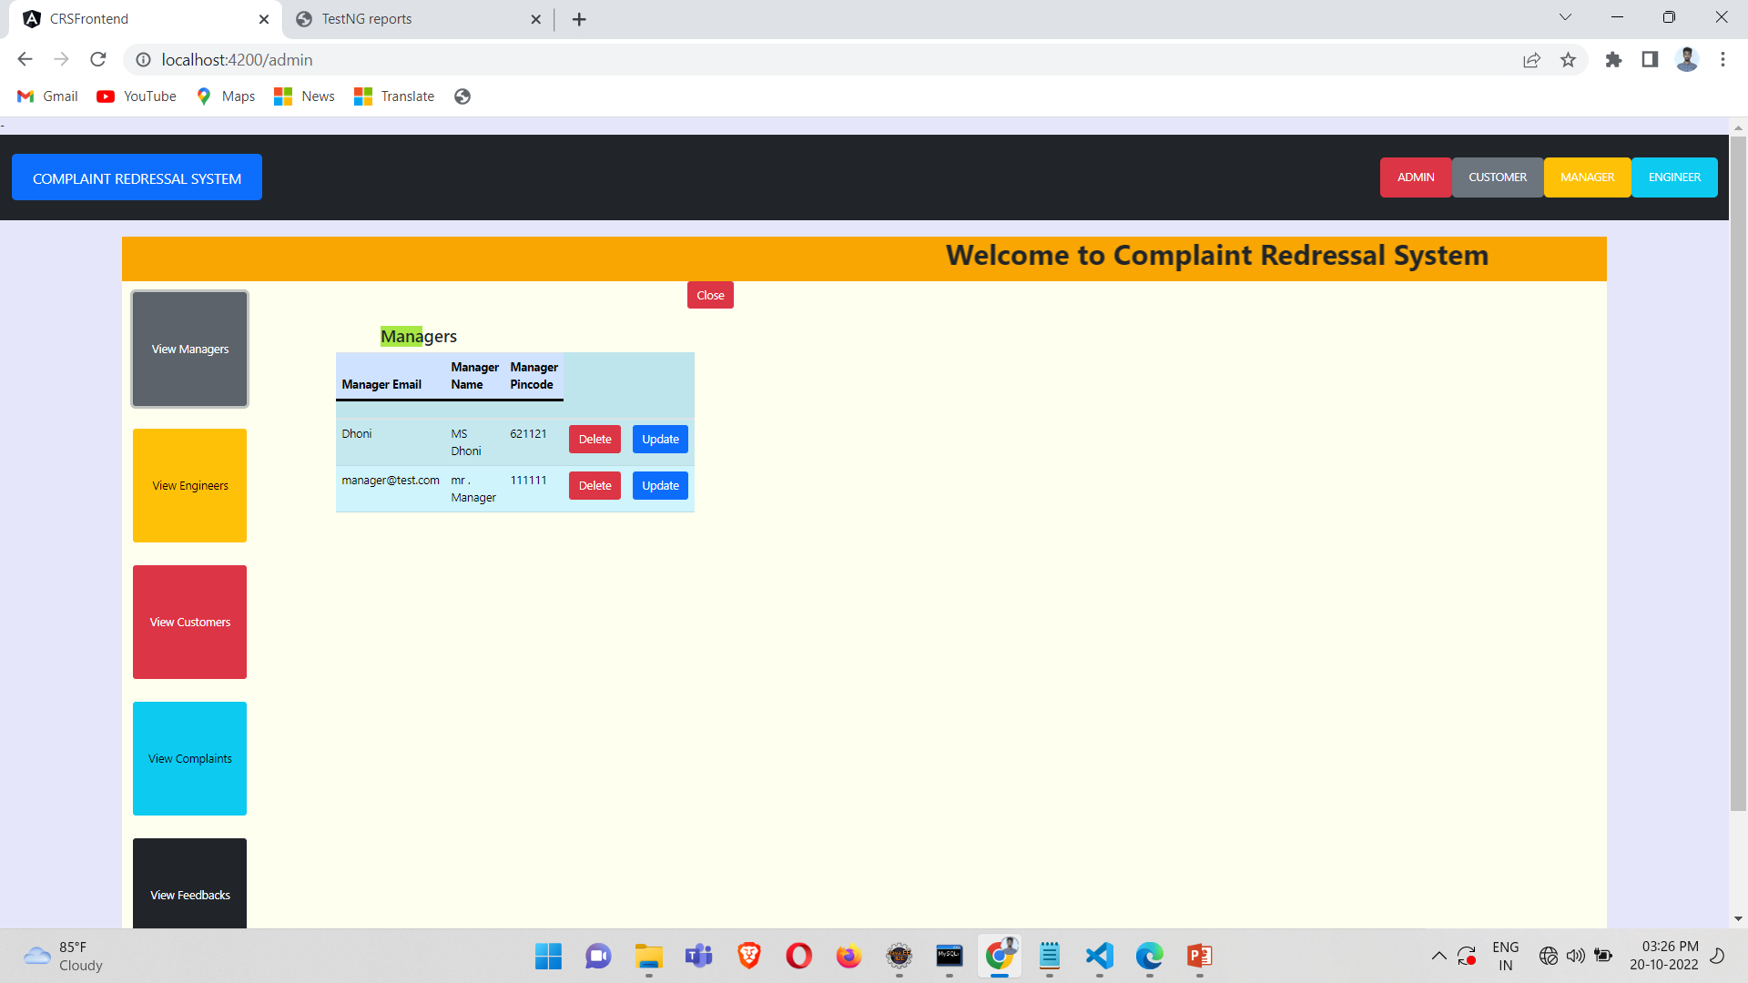

Slide 32
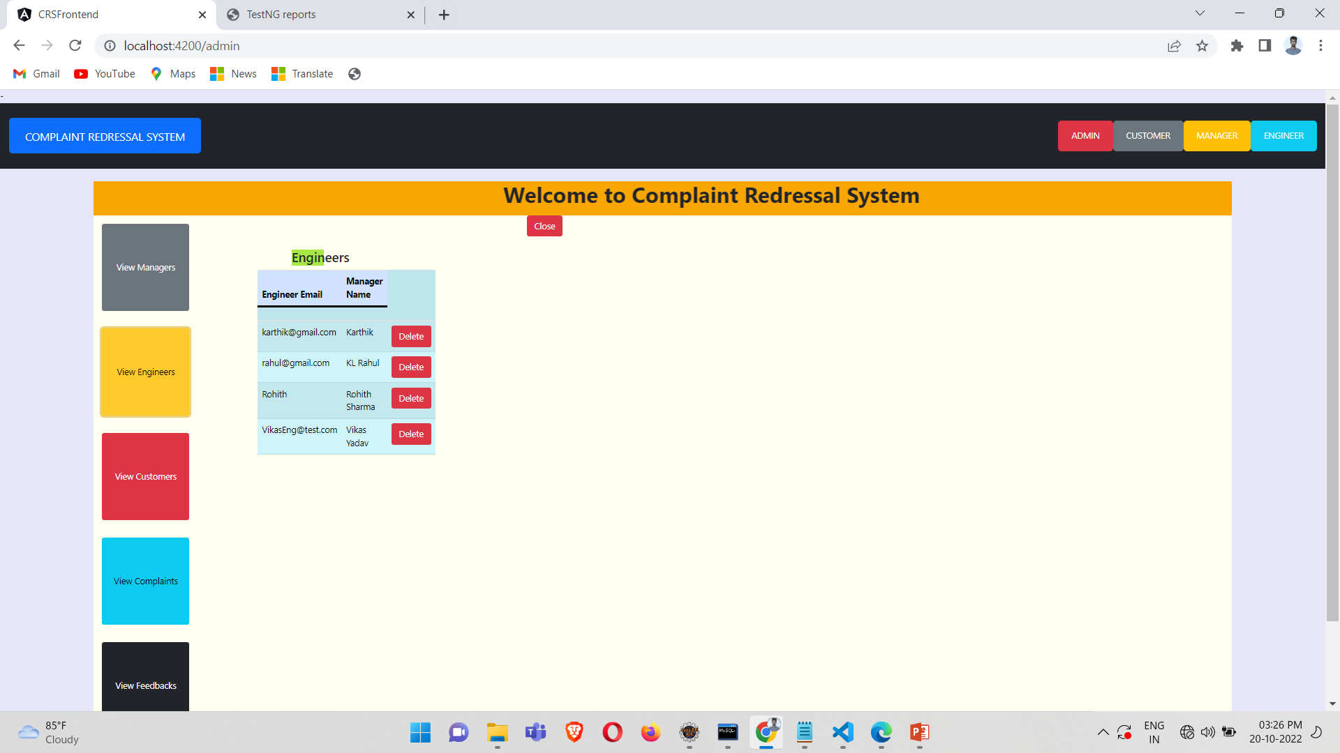

Slide 33
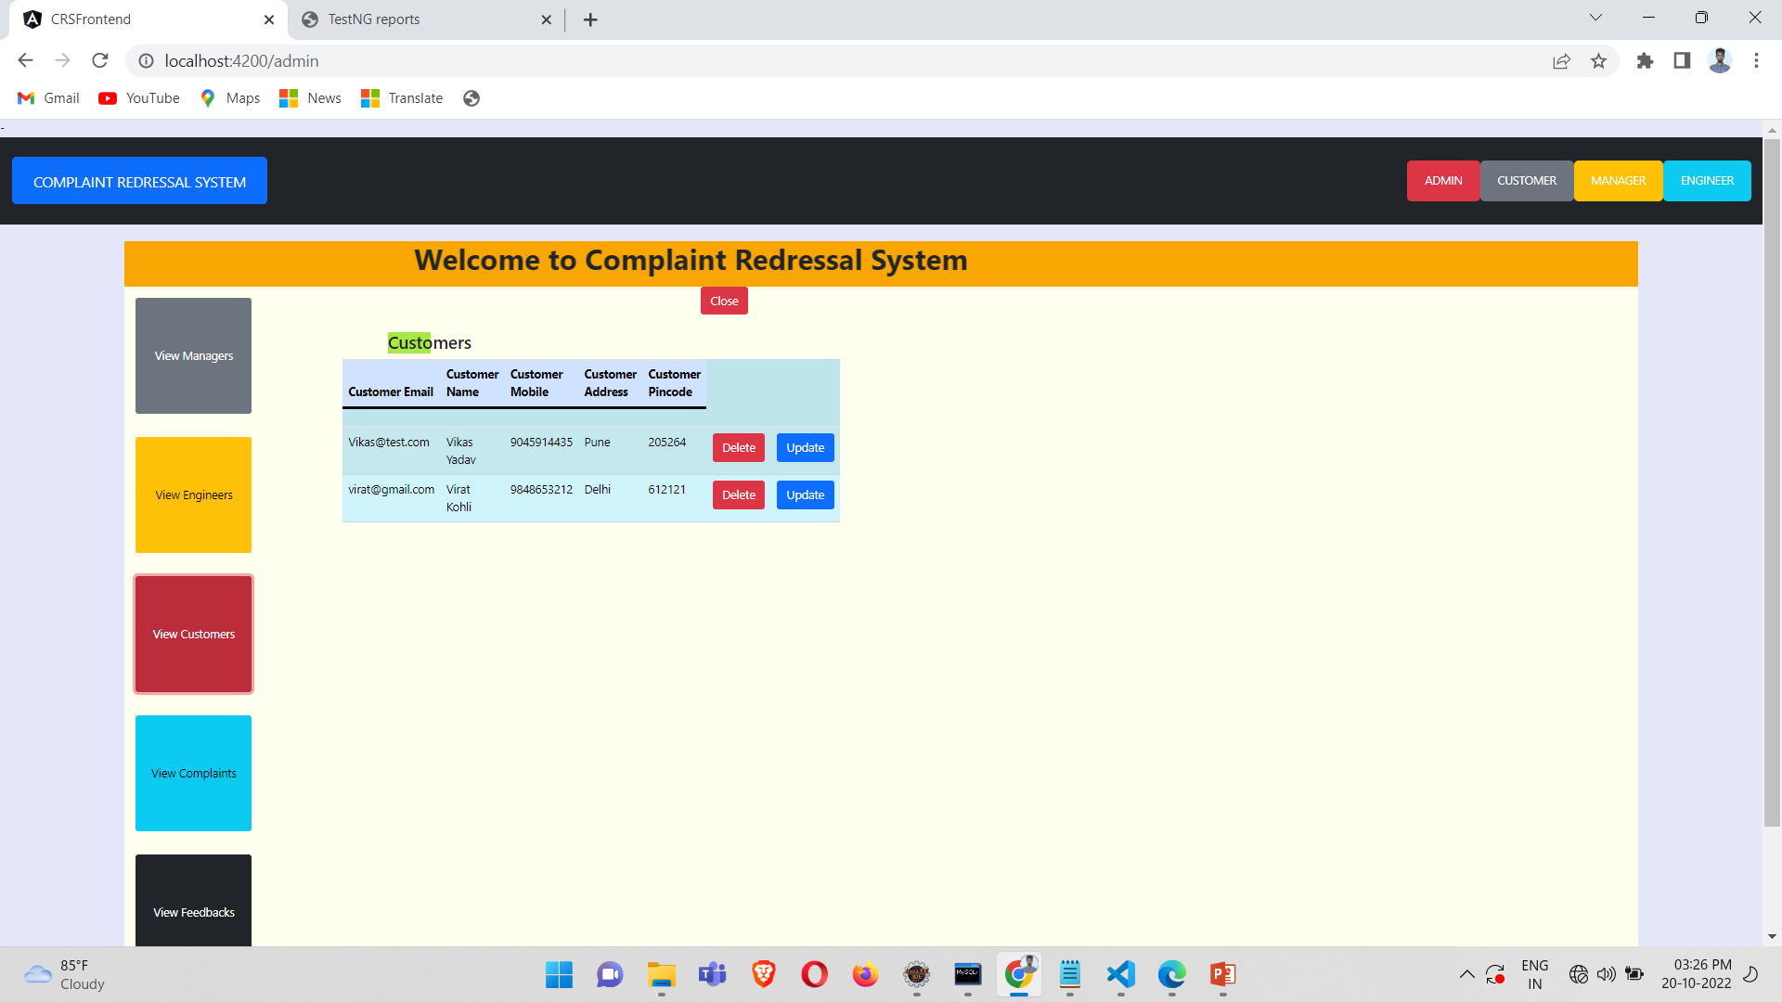

Slide 34
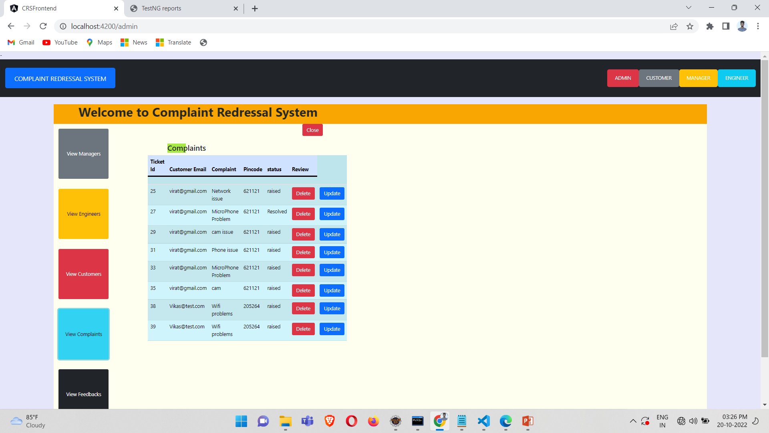

Slide 35
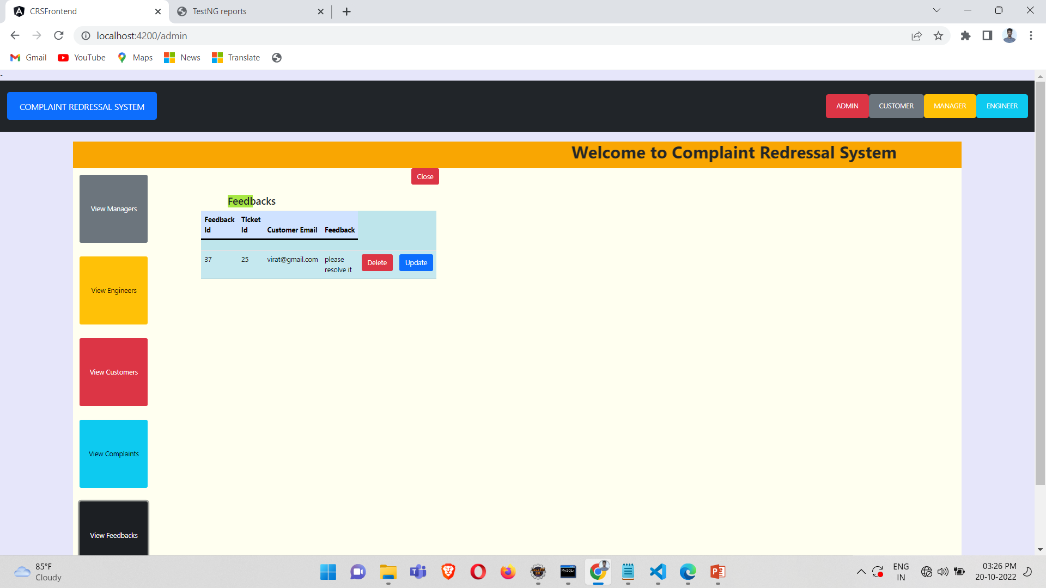

Slide 36
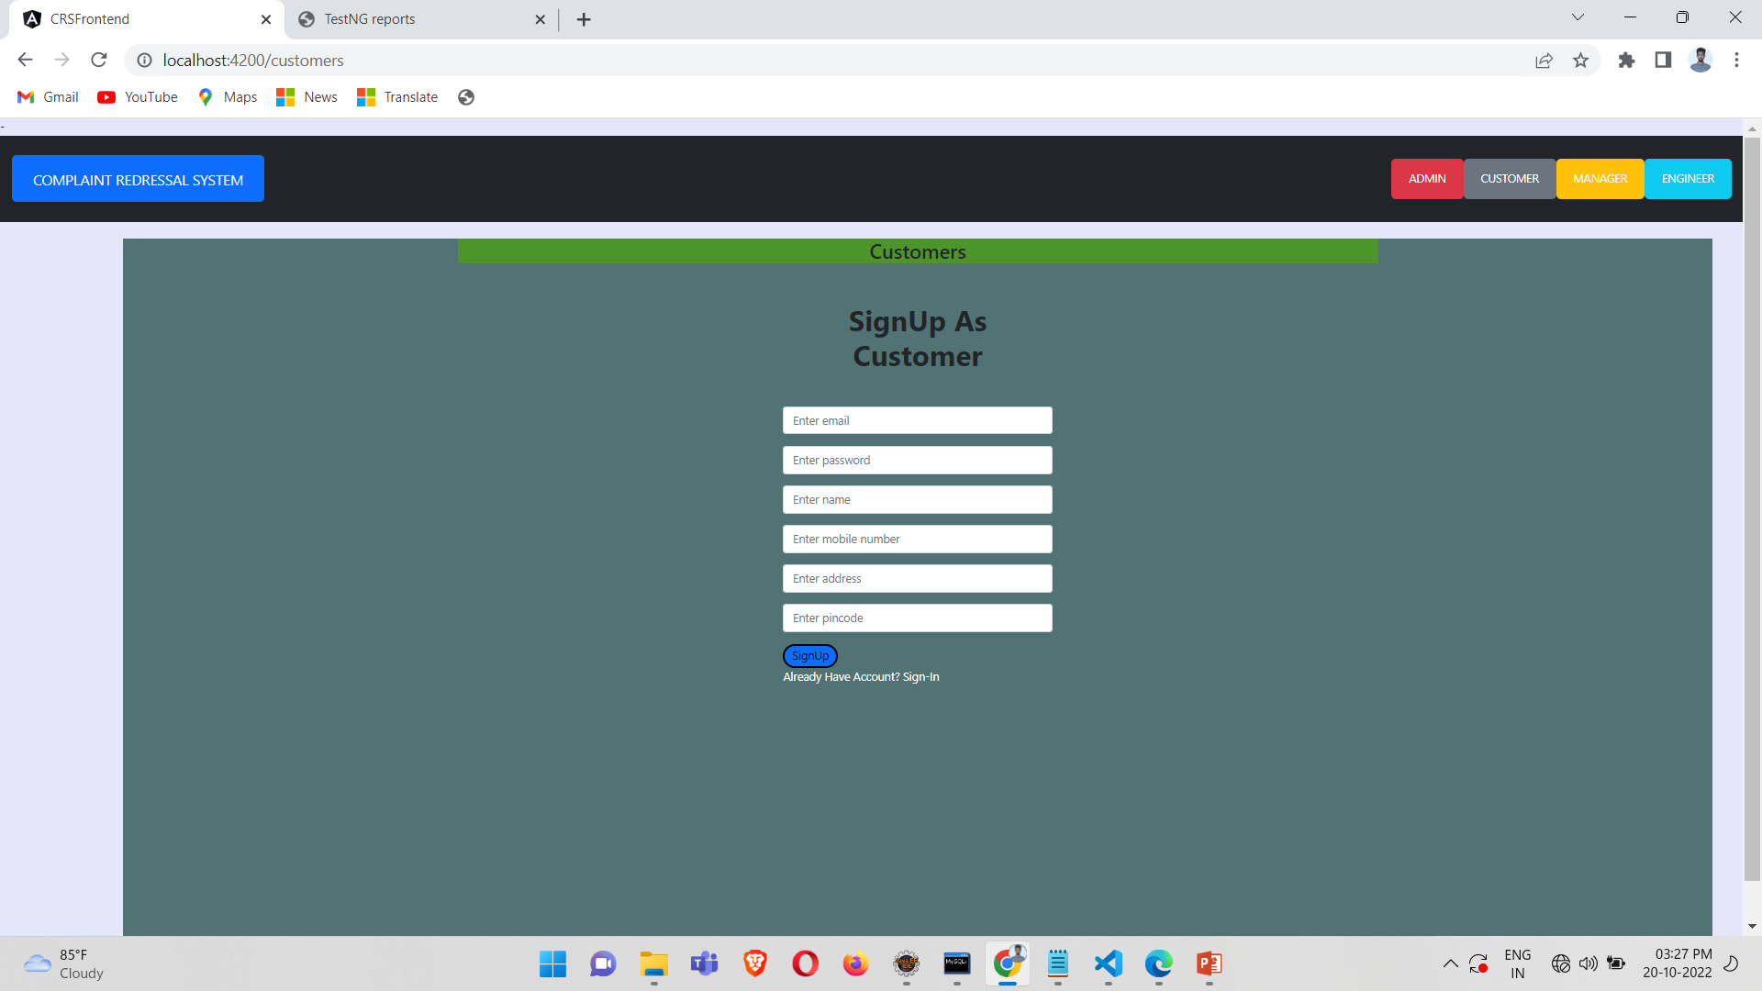

Slide 37
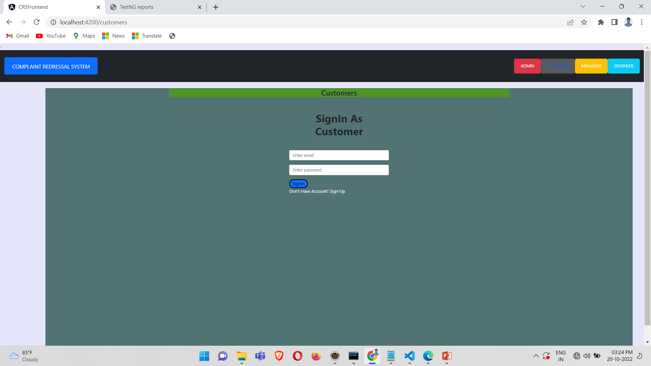

Slide 38
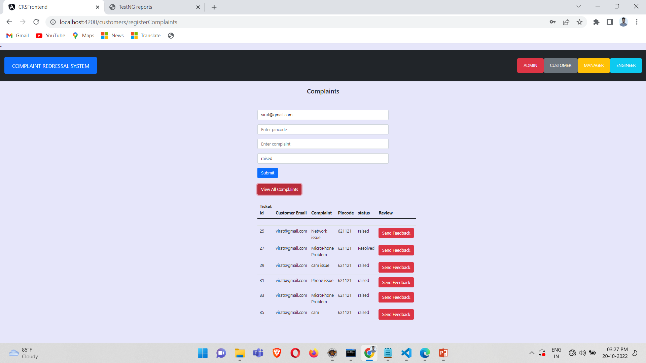

Slide 39
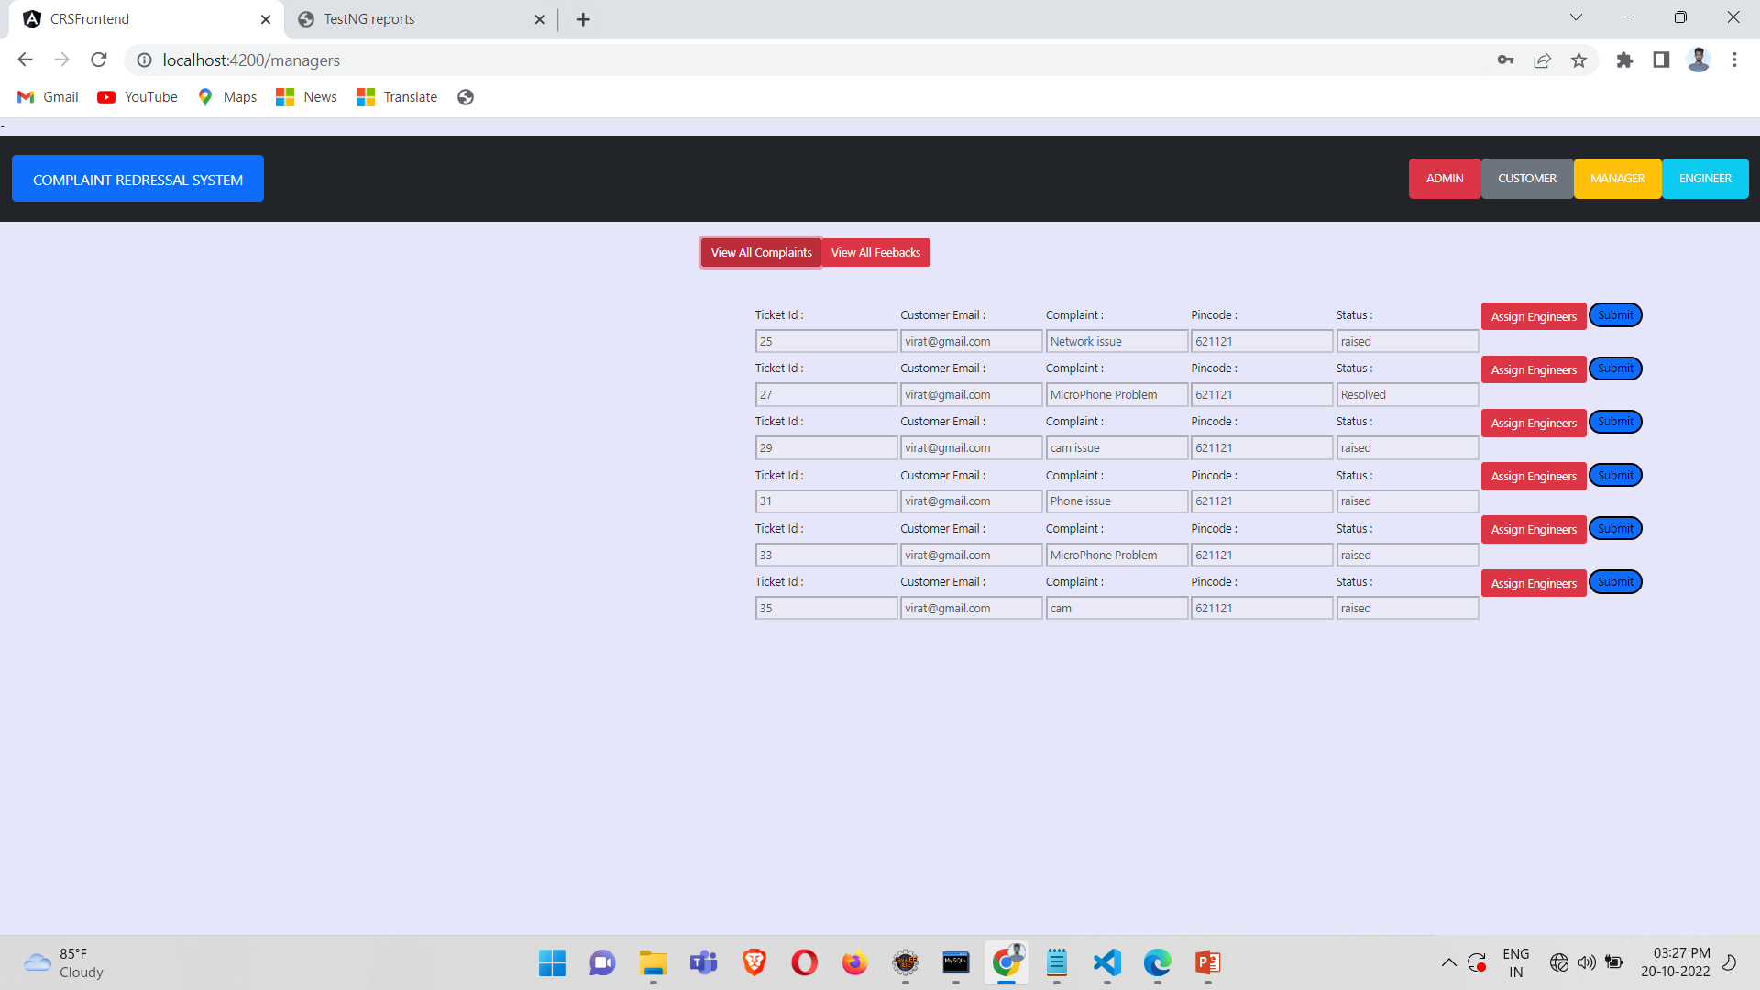

Slide 40
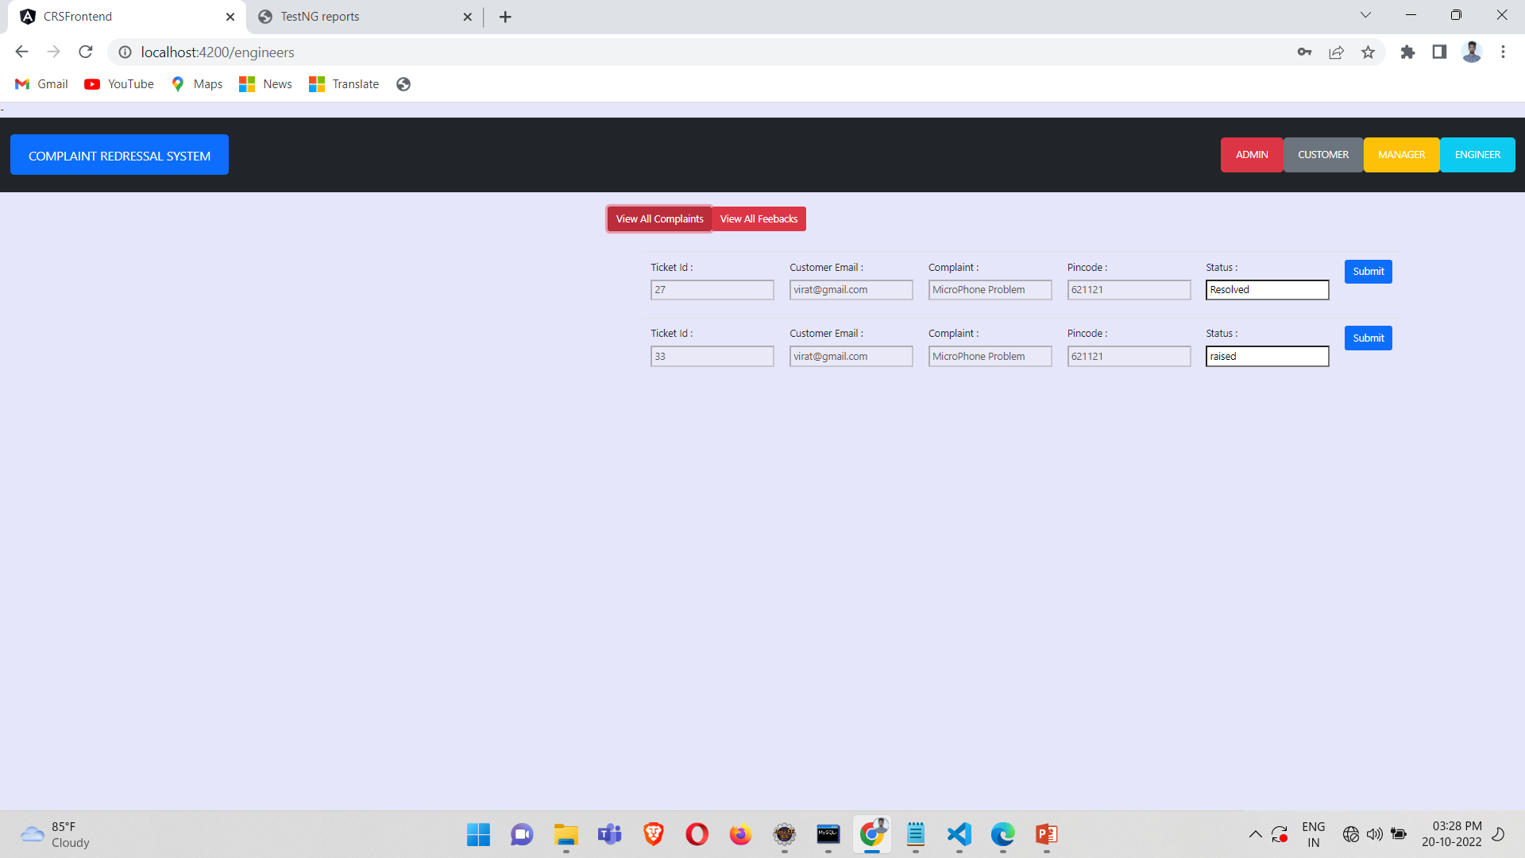

Slide 41
conclusion
The complaint redressal system is a web-based application, developed using spring framework as a backend and angular as a front-end.
Enables the Administrator to create and manages the lifecycle of different types of users
-> Customer
-> Manager
-> Engineer
Enables the customers to login to the portal to raise and track complaints related to the services availed by them.
Enables the manager to login, view the complaints raised by the customers and assign the ticket to the engineers based on the PIN Code.
Enables the engineers to pick up the tickets, work on them, enter the status of the task. They can update the status as Resolved/Esclated.

